Slide 1
Concepts of Boolean Algebra

Slide 2
Lecture 22 The Karnaugh Map
Lecture delivered by:
Deepak V.

Slide 3
Topics
The Karnaugh Map
Construction of a Karnaugh map
Draw K-Map from a Truth Table

Slide 4
Objectives
At the end of this lecture, student will be able to:
Acquire the knowledge of the Karnaugh map
Construction of a Karnaugh map
Construction of a Karnaugh map for 3 and 4 variables
Draw K-Map from a Truth Table

Slide 5
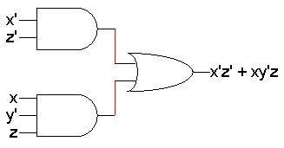
Karnaugh map
Boolean algebra helps us simplify expressions and circuits
Karnaugh Map: A graphical technique for simplifying a Boolean expression into either form:
minimal sum of products (MSP)
minimal product of sums (MPS)
Goal of the simplification.
There are a minimal number of product/sum terms
Each term has a minimal number of literals
Circuit-wise, this leads to a minimal two-level implementation

Slide 6
Construction of a Karnaugh Map
Square or rectangle divided into cells
Each cell represents a line in the truth table
Cell contents are the value of the output variable on that line of the truth table

Slide 7
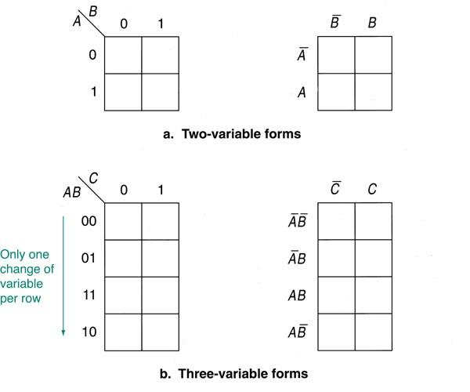
Construction of a Karnaugh Map

Slide 8
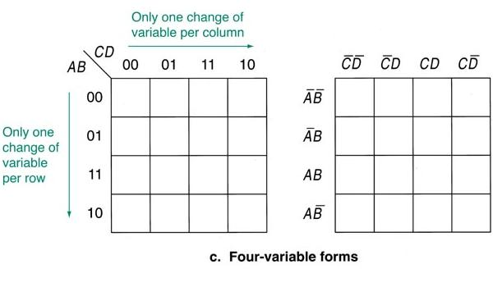
Construction of a Karnaugh Map

Slide 9
Karnaugh map
Karnaugh maps, or K-maps, are often used to simplify logic problems with 2, 3 or 4 variables
Cell = 2^{n} ,where n is a number of variables
For the case of 2 variables, we form a map consisting of 2²=4 cells as shown in Figure
A
A
A
0
1
0
1
0
1
B
B
B
00 | 10
01 | 11
0
0
0
2
0
1
1
1
1
3
Maxterm
Minterm

Slide 10
Karnaugh map
3 variables Karnaugh map
Cell = 2³=8
AB
C
00
01
11
10
0
2
6
4
0
1
3
7
5
1

Slide 11
Karnaugh map
4 variables Karnaugh map
AB
CD
00
01
11
10
0
4
12
8
00
1
5
13
9
01
3
7
15
11
11
2
6
14
10
10

Slide 12
Karnaugh map
The Karnaugh map is completed by entering a '1‘(or ‘0’) in each of the appropriate cells
Within the map, adjacent cells containing 1's (or 0’s) are grouped together in twos, fours, or eights
2-variable Karnaugh maps are trivial but can be used to introduce the methods you need to learn. The map for a 2-input OR gate looks like this:
A
0
1
B
0
1
A
A | B | Y
0 | 0 | 0
0 | 1 | 1
1 | 0 | 1
1 | 1 | 1
1
1
1
B
A+B

Slide 13
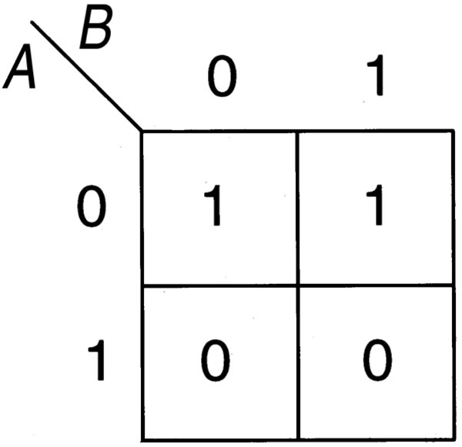
Construction of a Karnaugh Map

Slide 14
K-map Cell Coordinates
Adjacent cells differ by only one variable
Grouping adjacent cells allows canceling variables in their true and complement forms
Grouping Cells
Cells can be grouped as pairs, quads, and octets
A pair cancels one variable
A quad cancels two variables
An octet cancels three variables

Slide 15
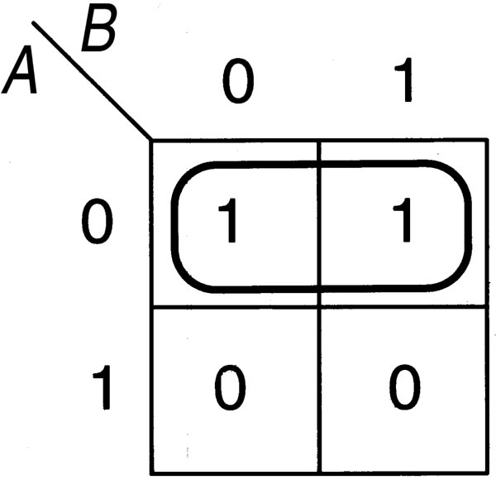
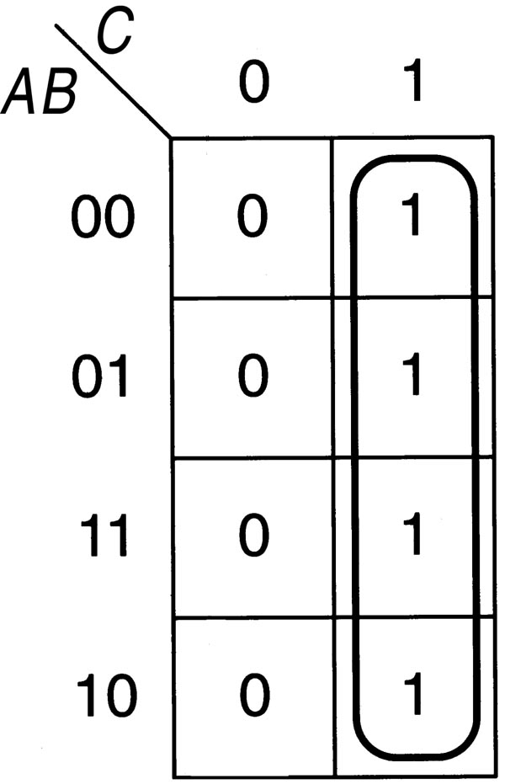
Grouping Cells

Slide 16
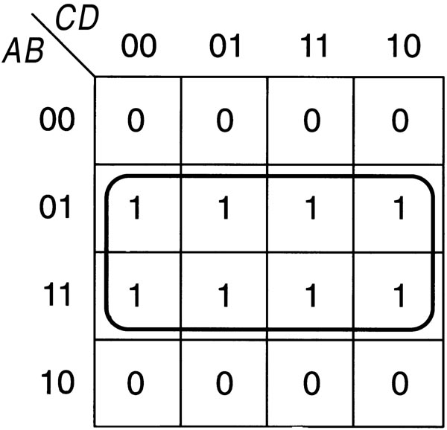
Grouping Cells

Slide 17
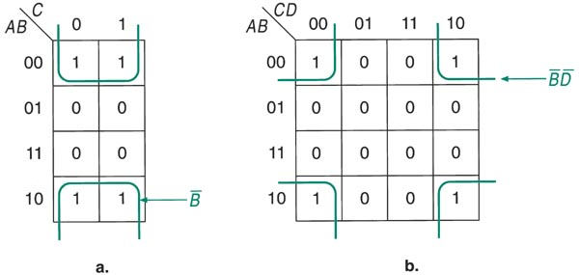
Grouping Cells along the Outside Edge
The cells along an outside edge are adjacent to cells along the opposite edge
In a four-variable map, the four corner cells are adjacent

Slide 18
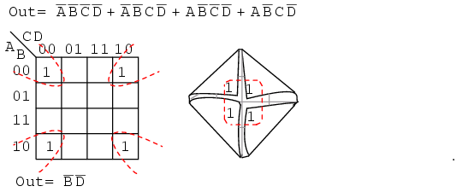
Grouping Cells along the Outside Edge

Slide 19
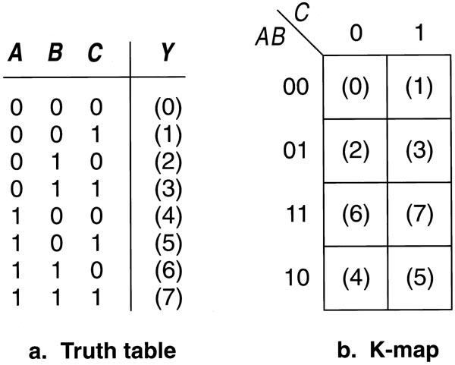
Loading a K-Map from a Truth Table
Each cell of the K-map represents one line from the truth table
The K-map is not laid out in the same order as the truth table

Slide 20
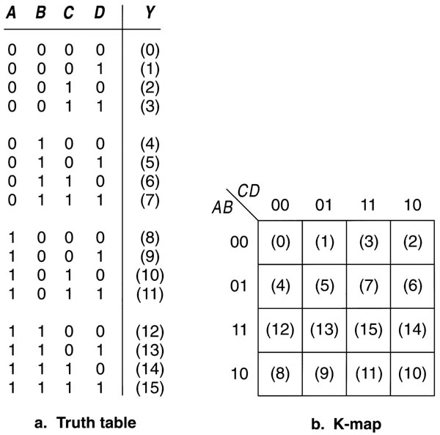
Loading a K-Map from a Truth Table

Slide 21
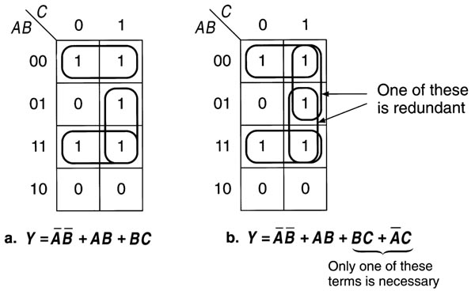
Multiple Groups
Each group is a term in the maximum SOP expression
A cell may be grouped more than once as long as every group has at least one cell that does not belong to any other group. Otherwise, redundant terms will result

Slide 22
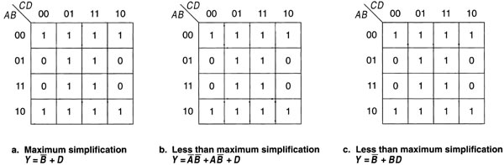
Maximum Simplification
Achieved if the circled group of cells on the K-map are as large as possible
There are as few groups as possible

Slide 23
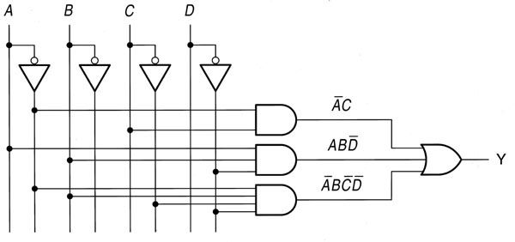
Using K-Maps for Partially Simplified Circuits
Fill in the K-map from the existing product terms
Each product term that is not a minterm will represent more than one cell
Once completed, regroup the K-map for maximum simplification

Slide 24
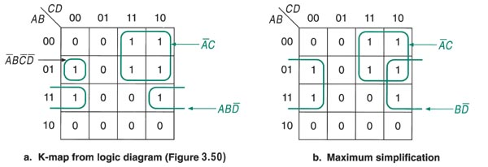
Using K-Maps for Partially Simplified Circuits

Slide 25
Summary
K-maps are an alternative to algebra for simplifying expressions
The result is a MSP/MPS, which leads to a minimal two-level circuit
K-maps are really only good for manual simplification of small expressions
K-maps can also be used for POS minimization

